Slide 1
ONLINE MART APPLICATION
UNDER THE GUIDANCE OF:
POOJA MEHTA
SUBMITTED BY:
SYED SAQEEB SAQLIAN
B.AKASH
CHETHAN
GAGANA .M V
MANIMARAN.R

Slide 2
INTRODUCTION
The ONLINE MART Project has been developed on AngularJS, NodeJS and Mysql. We are providing angularjs projects with source code, database, and documentation. The ONLINE MART major project is an application which is based on man- aging the order and sell the MART Products online. This application is very simple and impressive. The main objective behind this angularjs application ONLINE MART is to provide all the details about MART Products.
There is a single role user that is admin in this project who can manage all the activity. Admin can manage MART Products, MART Products Type, Sells and also managed the SALEs details. This AngularJS major project is very helpful for maintainINg the sales activity in MART Products because it is very complex task to manage the daily sales manually. In this project admin can see the details of MART Products, mart Products Type etc. Only Admin can edit or delete the details of the MART Products.

Slide 3
PROJECT OBJECTIVE
The purpose of our application is to provide customers with a convenient and user-friendly platform to browse and purchase products online. It aims to bridge the gap between consumers and a wide range of VEGETABLES,SNACKS,FRUITS,DAIRY PRODUCTS,CERALS,FROZEN FOODS. The application will offer a secure and efficient shopping experience, ensuring customer satisfaction and loyalty.
This major Java Online MART Store provides online interface and the customers can easily place the order of Product on few clicks. This are various features available in Online MART Store. As this online application enables the end users to register to the system online, select the Product items of their choice from the menu list, and order Product online. The Online MART Store is based on ordering of the Product online. This Online Store allows the user to select the desired Product from a sEt of avaliable menu ITEms. The customer can easily place orders for the Product items of their choice. For ordering the Product customer needs to register into the system with their detaIls and after the registration, customer can filtered out the Product according to the Type. Category Payment, Order ad the Product into the cart and make payment.

Slide 4
TECHNOLOGY USED
JAVA
Java is an object-oriented programming (OOP) language, which means it supports the principles and concepts of object-oriented programming.
Java
HTML
angular
ANGULAR
HTML, which stands for HyperText Markup Language, is the standard markup language used for creating and structuring web pages.
Angular is a TypeScript-based framework that uses HTML, CSS, and JavaScript to build robust and scalable single-page applications.
Postman
POSTMAN
JAVASCRIPT
Postman is a popular collaboration platform and toolset used by developers to build, test, and document APIs
JavaScript is a widely used programming language primarily used for web development.

Slide 5
PROPOSED SYSTEM
The platform for customers to browse proposed system of an online mart store aims to provide a seamless and user-friendly, select, and purchase mart products conveniently from the comfort of their homes.
Given comprehensive full-stack project combines the power of Java Spring Boot, Hibernate, MySQL, and Angular. This system aims to address the challenges of modern web development by utilizing Java Spring Boot for rapid backend development, Hibernate for seamless communication with the MySQL database, and Angular for creating dynamic and interactive user interfaces. By leveraging these technologies, we can deliver a robust, scalable, and user-friendly application that meets the demands of today's web development landscape.

Slide 6
REQUIRED SPECIFICATIONS
HARDWARE CONFIGURATION | SOFTWARE CONFIGURATION
Operating System : Windows 10 and above | Software IDE: Eclipse, Postman, MySQL, VS Code.
Hard Disk: 500 GB | Language: JAVA, Type Script, HTML, CSS
RAM: 8 GB | Front End: Angular, Boot Strap
 | Back End: Spring Boot, MySQL.

Slide 7
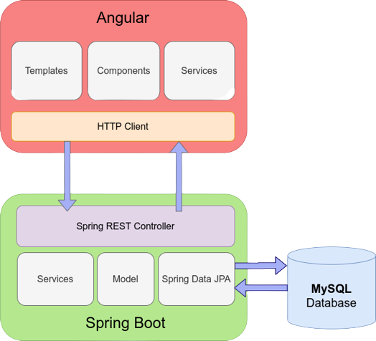
CONNECTION TO DATABASE

Slide 8
MODULES
01
ADMIN :
Registration and Login.
02
CUSTOMER:
SignUp and Login.
03
PRODUCT LIST :
Add/Edit Mart items by Admin.
04
CART:
Customer can add Mart Products from Product list.
05
ORDER :
06
PAYMENT :
Displays items present in customer’s cart and order status.
Customer has to pay for placing of order.

Slide 9
SPRING ANNOTATIONS
@Controller : | The @Controller annotation indicates that a particular class serves the role of a controller. Spring Controller annotation is typically used in combination with annotated handler methods based on the @RequestMapping annotation.
@Autowired | The @Autowired annotation provides more fine-grained control over where and how auto-wiring should be accomplished. Autowiring feature of spring framework enables you to inject the object dependency implicitly. It internally uses setter or constructor injection.
@RequestMapping | The @RequestMapping is one of the most common annotation used in Spring Web applications. This annotation maps HTTP requests to handler methods of MVC and REST controllers.
@Entity | The @Entity annotation specifies that the class is an entity and is mapped to a database table.
@Table | The @Table annotation is used to create a table in database.
@JoinColumn | The @JoinColumn is used to specify a column for joining an entity association or element collection.

Slide 10
SPRING ANNOTATIONS
@PutMapping | The @PutMapping is used for update the records.
@PostMapping | The @PostMapping is used to create a resource Mapping.
@GetMapping | The @GetMapping is used to read all the inserted records.
@DeleteMapping | The @DeleteMapping is used to delete the records.
@PathVariable | The @Path Variable annotation is used to extract the value from the URL.
@RequestParam | The @RequestParam annotation is used to read the form data and bind it automatically to the parameter present in the provided method.

Slide 11
SPRING ANNOTATIONS
@Request Body | The @RequestBody annotation is applicable to handler methods of spring controller. spring should deserialize a request body into an object.
@OneToOne Mapping | The @OneToOne JPA annotation is used to map the source entity with the target entity, Hibernate maps the tables in your database to the Entity classes in your application.
@OneToMany Mapping | The @OneTo-Many relationship between table A and table B indicates that one row in a table A link to many rows in table B but one row in table B links to only one row in table A.
@ManyToOne Mapping | The @Many-to-One mapping means that many instances of this entity are mapped to one instance of another entity.
@ExceptionHandler | The @ExceptionHandler is an annotation used to handle the specific exceptions and sending the custom responses to the client.
@ControllerAdvice | A controller advice allows you to use exactly the same exception handling techniques but apply them across the whole application, not just to an individual controller. You can think of them as an annotation driven interceptor.

Slide 12
ADVANTAGES
REMOTE ORDERING
USER FRIENDLY INTERFACE
Customer can order whenever they want.
This website was designed using angularjs, html and css which makes it very attarctive and easy to use.
AFFORDABILITY
Time saving & 24*7 availability
This website offers affordable prices and Best in market prices
This website is techsavy time saving and 24*7 available site.

Slide 13
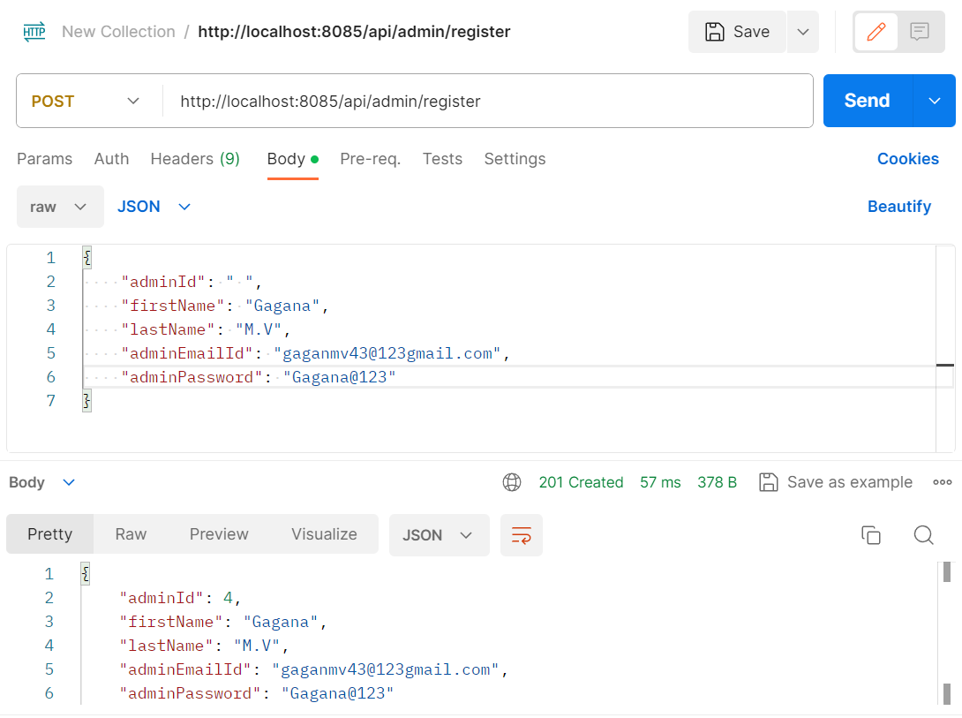
ADMIN REGISTRATION FROM POSTMAN

Slide 14
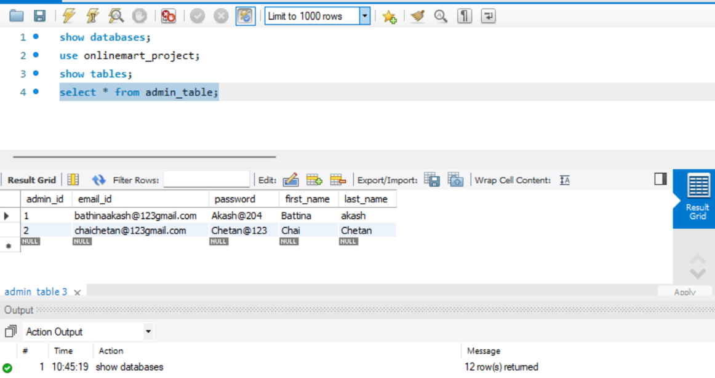
ADMIN TABLE

Slide 15
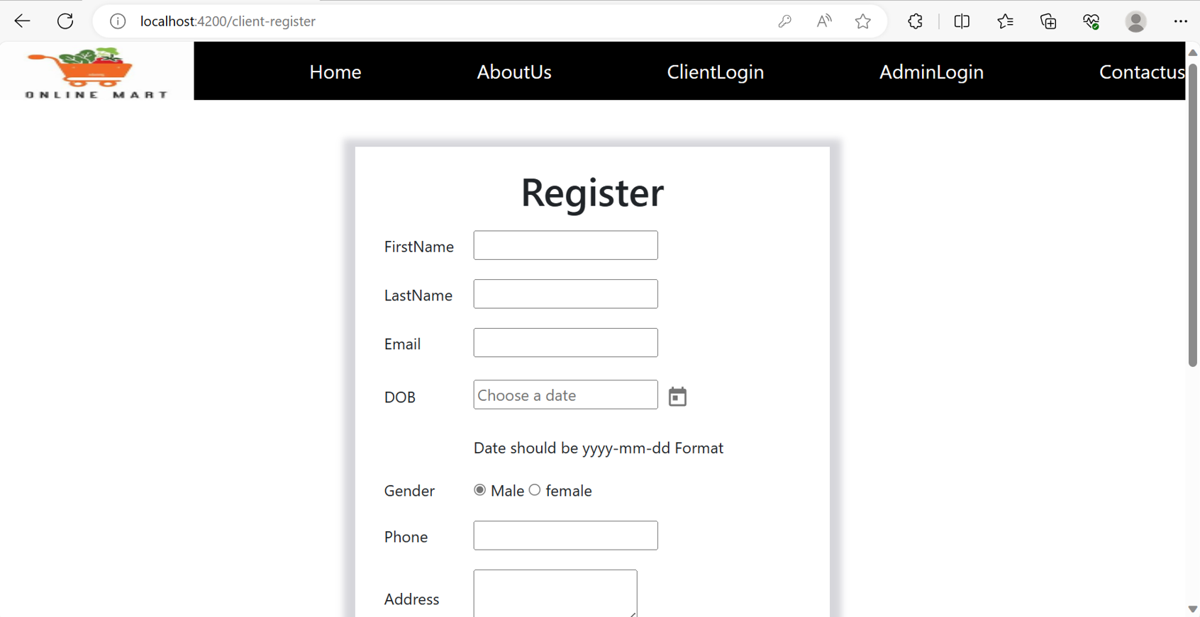
CUSTOMER REGISTRATION

Slide 16
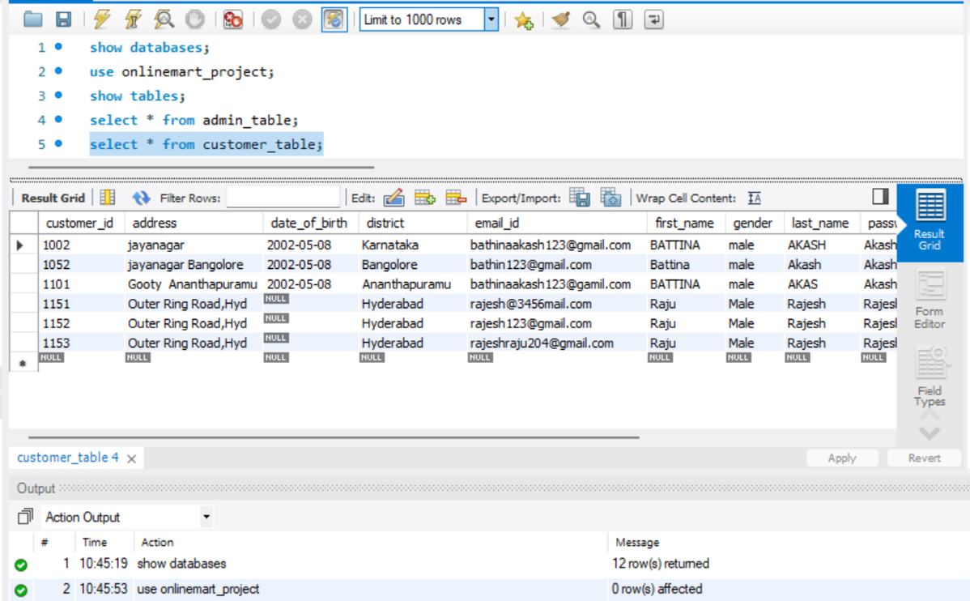
CUSTOMER TABLE

Slide 17
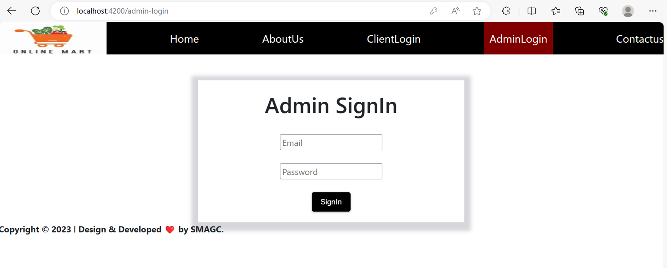
ADMIN SIGNIN

Slide 18
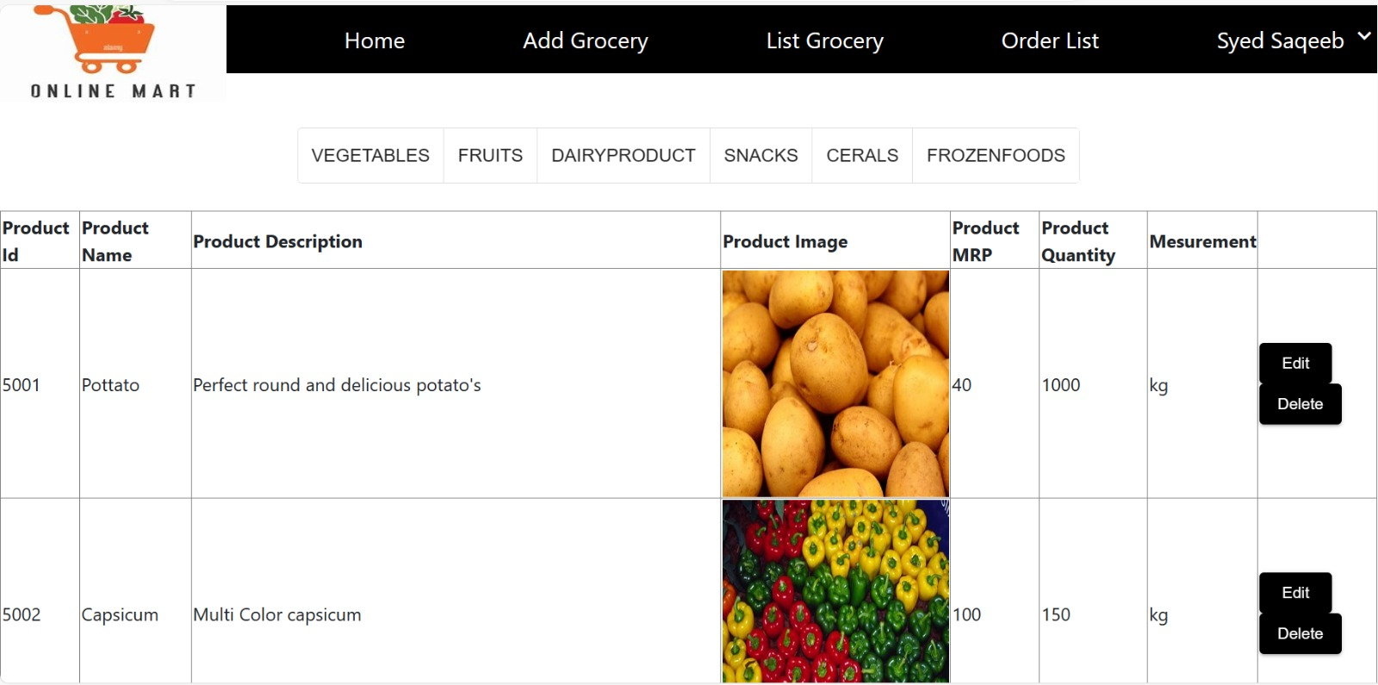
ADD ITEMS FROM ADMIN

Slide 19
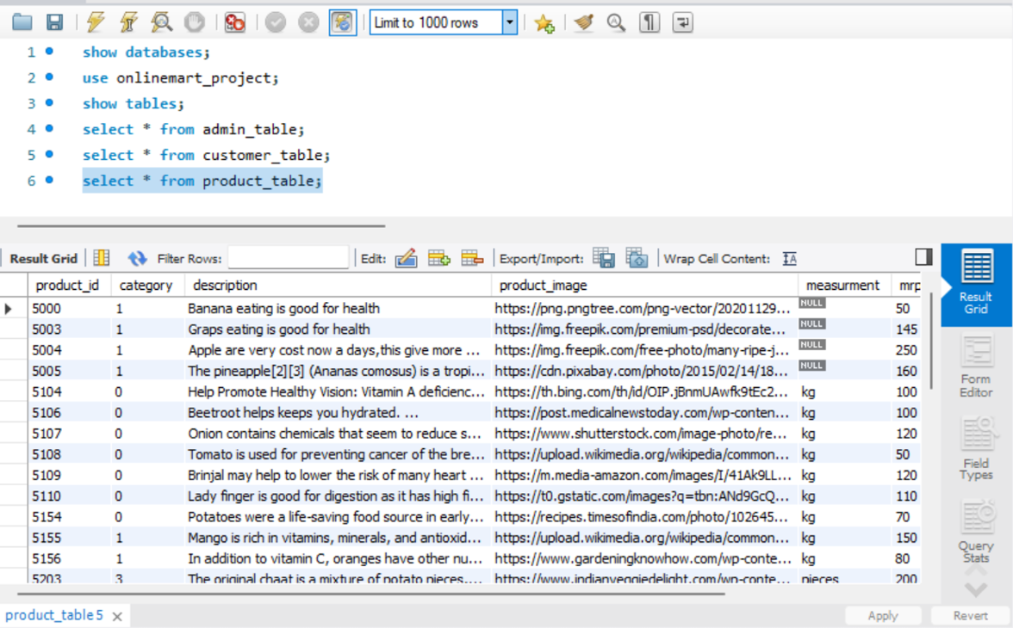
Cart PRODUCT TABLE

Slide 20
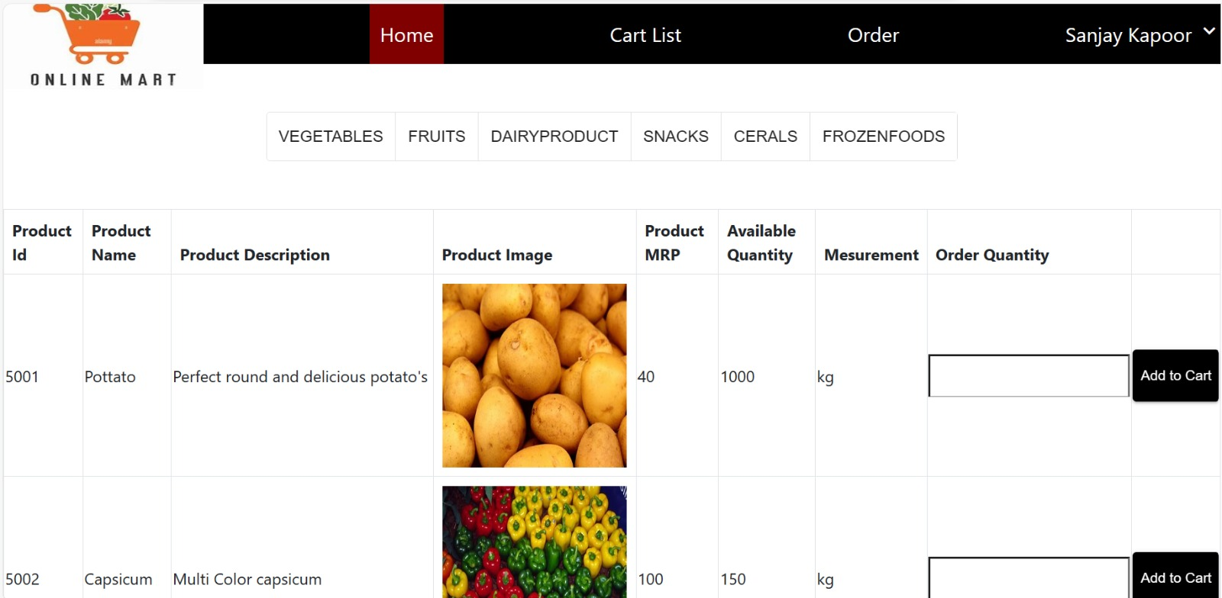
CART PRODUCT LIST

Slide 21
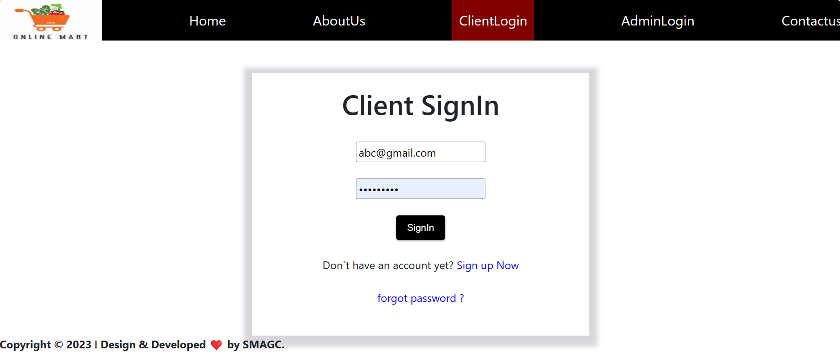
CUSTOMER SIGNIN

Slide 22
CUSTOMER HOME PAGE

Slide 23
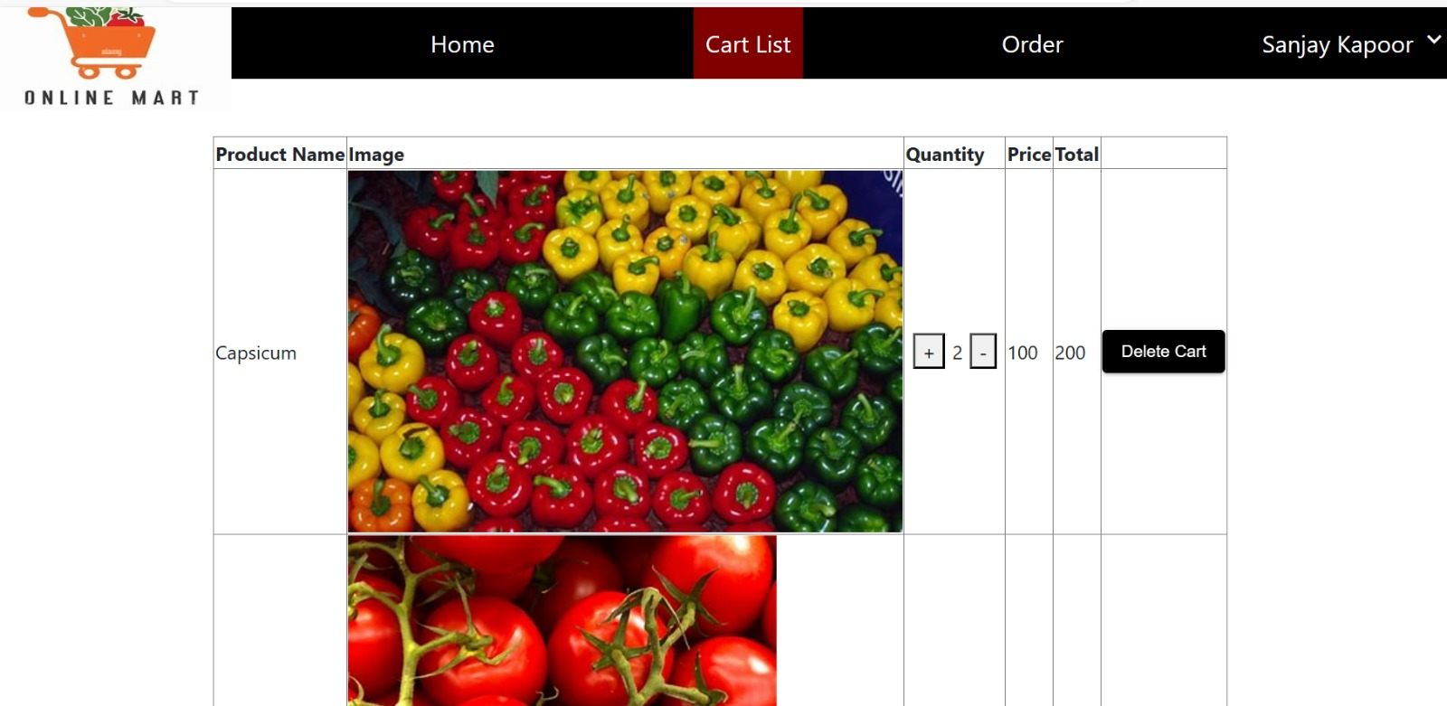
CUSTOMER CART

Slide 24
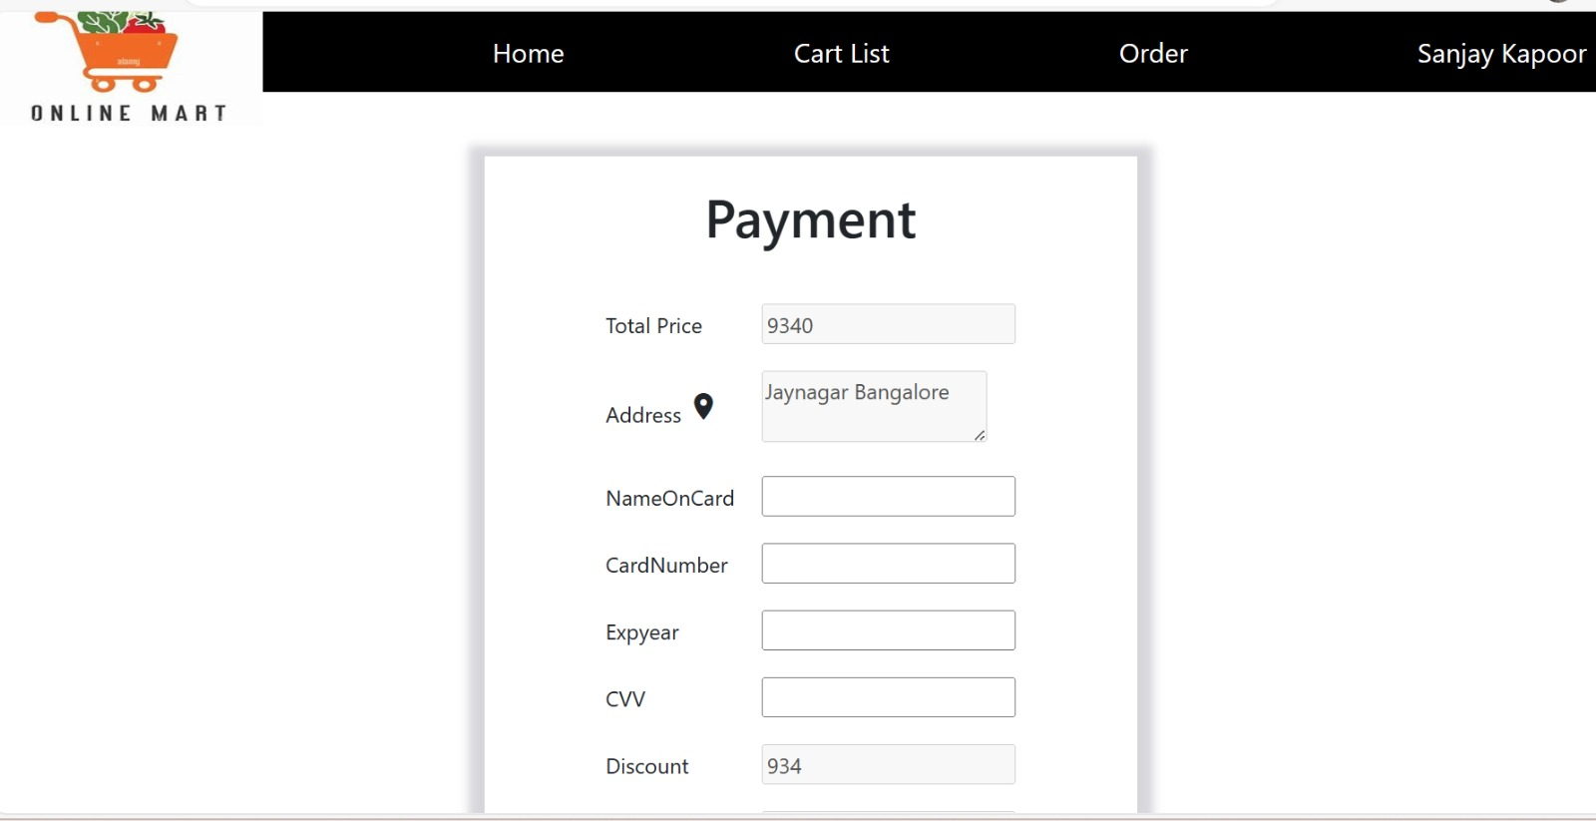
CUSTOMER PAYMENT

Slide 25
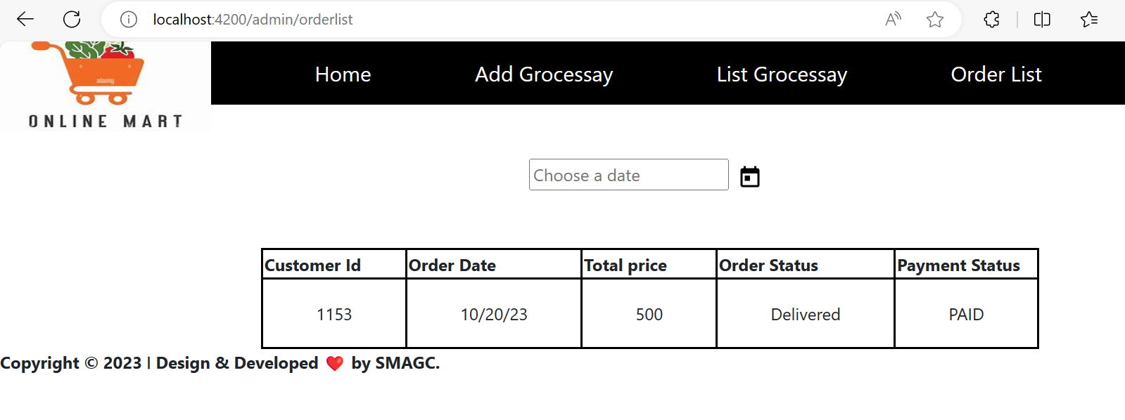
CUSTOMER ORDER STATUS

Slide 26
CONCLUSION
The online mart store in Java offers a modern and convenient way for customers to browse, select, and purchase mart products from the comfort of their homes . With a comprehensive product catalog, robust search and filtering capabilities, and a seamless shopping cart and checkout process, users can easily find and purchase their desired products.
As the online mart store continues to evolve, future enhancements such as integration with social media and personalized recommendations will further enhance the user experience.
By leveraging the power of Java and modern technologies, we have created a robust and scalable platform that meets the needs of today's tech-savvy consumers.

Slide 27
THANK YOU

